Slide 1
Discrete Event (time) Simulation

Slide 2
What is a simulation?
“Simulation is the process of designing a model of a real system and conducting experiments with this model for the purpose either of understanding the behavior of the system or of evaluating various strategies (within the limits imposed by a criterion or set of criteria) for the operation of a system.”
-Robert E Shannon 1975
“Simulation is the process of designing a dynamic model of an actual dynamic system for the purpose either of understanding the behavior of the system or of evaluating various strategies (within the limits imposed by a criterion or set of criteria) for the operation of a system.”
-Ricki G Ingalls 2002

Slide 3
Why?
Analysis tool for predicating the effect of changes
-Potential changes to the system can be simulated and predicate their impact on the system.
Design tool to predicate the performance of new system
-Find adequate parameters before implementation.

Slide 4
Why Not?
When the problem can be solved by common sense.
When the problem can be solved analytically.
If it is easier to perform direct experiments.
If cost exceed savings.
If resource or time are not available.
If system behavior is too complex.
, etc.

Slide 5
What types of simulation are there?

Slide 6
Simulation Types
Static or dynamic models
Stochastic or deterministic models
Discrete or continuous models

Slide 7
Static vs. Dynamic
Dynamic
State variables change over time (System Dynamics, Discrete Event)
Static
Snapshot at a single point in time (optimization models, etc.)

Slide 8
Deterministic vs. Stochastic
Deterministic model
The behavior is entire predictable. The system is perfectly understood, then it is possible to predict precisely what will happen.
Stochastic model
The behavior cannot be entirely predicted.

Slide 9
Discrete vs. Continuous
Discrete model
The state variables change only at a countable number of points in time. These points in time are the ones at which the event occurs/change in state.
Continuous
The state variables change in a continuous way, and not abruptly from one state to another (infinite number of states).

Slide 10
Discrete Event Simulation
Dynamic Stochastic Discrete

Slide 11
How to Implement a Discrete Event Simulation?
Consider an example: Airport System
A certain airport contains a single runway on which arriving aircrafts must land.
Once an aircraft is cleared to land, it will use the runway, during which time no other aircraft can be cleared to land.
Once the aircraft has landed, the runway is available for use by other aircraft. The landed aircraft remains on the ground for a certain period of time before departing.

Slide 12
An Example: Airport System Single Server Queue
Server
Queue
Customers
Ground
Customer (aircraft)
Entities utilizing the system/resources
Server (runway)
Resource that is serially reused; serves one customer at a time
Queue
Buffer holding aircraft waiting to land

Slide 13
An Example: Airport System Single Server Queue
Server
Queue
Customers
Ground
Performance metrics
Average waiting time: average time that an aircraft must wait when arriving at an airport before they are allowed to land.
Maximum number of aircraft on the ground: helps to determine the required space of the parking area.

Slide 14
Simulation Development
Events
Stochastic model and system attributes
System States
Relationship among events
Time handling
Output statistics

Slide 15
An Example: Airport System Single Server Queue
Server
Queue
Customers
D
S_{f}
S_{s}
A
Ground
Events: an instantaneous occurrence that changes the state of a system
Arrival (A)
Finish Service (S_{f})
Start Service (S_{s})
Departure (D)

Slide 16
Stochastic Model and System Attributes
Customers
Arrival process: schedule of aircraft arrivals
Real trace
Probability model: distribution of inter-arrival time
i.i.d.
Uniform, normal, exponential …
Servers
How much service time is needed for each customer?
Probability model: i.i.d. and exponential distribution
How many servers?
Single

Slide 17
Stochastic Model and System Attributes
Queue
Service discipline - who gets service next?
First-in-first-out (FIFO), Last-in-first-out (LIFO), Priority, Weighted-fairness (WFQ), random …
Preemption?
Queue capacity?
k or infinite
Ground
Park time
Probability model: i.i.d. and exponential distribution

Slide 18

Stochastic Model and System Attributes
Uniform
Given max and min
0 ≦ random() < 1
= min + random() × (max - min)
Exponential
Given rate λ
@p.30 of lec1.ppt
Normal
Google is your friend!

Slide 19
How to verify the correctness of distribution generator?
ANS: you can verity it by using a program, Excel, Matlab, …

Slide 20

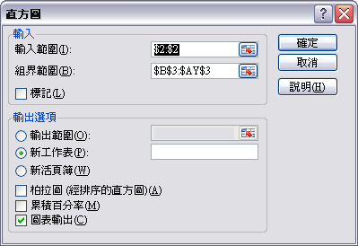

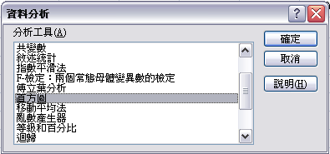
How to verify the correctness of distribution generator via Excel?
Inputting or generating sample data
Generating pdf
Applying “Histogram” of “Data Analysis”
“Data Analysis” is in “Analysis Toolpack” (分析工具箱)
✓

Slide 21
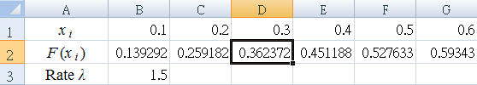
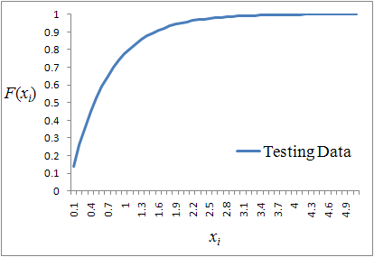
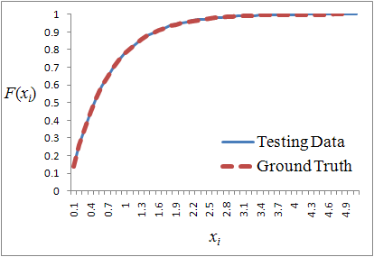
How to verify the correctness of distribution generator via Excel?
Generating Broken-line graph for cdf of x_{i}
Generating ground truth of cdf

Slide 22
Simulation Development
Events
Stochastic model and system attributes
System States
Relationship among events
Time handling
Output statistics

Slide 23
System States
System state
A collection of variables in any time that describe the system
Event
An instantaneous occurrence that changes the state of a system
State 1
Event Y
Event X
Event X
Event Y
State 3
State 2

Slide 24
An Example: Airport System Single Server Queue
Server
Queue
Customers
D
S_{f}
S_{s}
A
Ground
System States (Q:3 G:2 B:y)
Q: # of aircrafts waiting for landing
G: # of aircrafts on the ground
B: y/n; y if the runway is busy

Slide 25
An Example: Airport System Single Server Queue
Server
Queue
Customers
D
S_{f}
S_{s}
A
Ground
Q:3 G:1
B:y
A
D
Q:4 G:2
B:y
Q:3 G:2
B:y
Q:2 G:3
B:y
_{IF Q>0}
Q:3 G:3
B:n
S_{f}
S_{s}

Slide 26
Simulation Development
Events
Stochastic model and system attributes
System States
Relationship among events
Time handling
Output statistics

Slide 27
Relationships among Events
Each Event has a timestamp indicating when it occurs
System States
Q: # of aircrafts waiting for landing
G: # of aircrafts on the ground
B: y/n, y if the runway is busy
Arrival Event A
@ t
N
Start Service Event S_{s}
@ t
B?
Y
Q+ +
B=Y
Arrival Event A
@ t+ArrivalTime()
Finish Service Event S_{f}
@ t+ServiceTime()

Slide 28
Relationships among Events
Finish Service Event S_{f}
@ t
System States
Q: # of aircrafts waiting for landing
G: # of aircrafts on the ground
B: y/n, y if the runway is busy
G+ +
Y
Start Service Event S_{s}
@ t
Q > 0?
N
B=N
Q--
Departure Event D
@ t+ParkTime()
Finish Service Event S_{f}
@ t+ServiceTime()

Slide 29
Relationships among Events
Departure Event D
@ t
System States
Q: # of aircrafts waiting for landing
G: # of aircrafts on the ground
B: y/n, y if the runway is busy
G--

Slide 30
Simulation Development
Events
Stochastic model and system attributes
System States
Relationship among events
Time handling
Output statistics

Slide 31
Time Handling
How to progress Simulation time?
Time-slices Approach
Processing
Departure Event D
@ 00:59:06
Finish Service Event S_{f}
@ 00:17:49
Processing
Processing
Finish Service Event S_{f}
@ 01:22:11
Arrival Event A
@ 00:48:37
Arrival Event A
@ 00:02:19
A time-slice=5 min
Simulation time
Inefficient
Inaccurate
Do Nothing
Do Nothing
Do
Do
Do
Do
Do Nothing
t = 00:45
t = 00:00
t = 00:30
t = 00:35
t = 00:40
t = 00:05
t = 00:10
t = 00:15
t = 00:20
t = 00:25
t = 00:50

Slide 32
For This Homework
DO NOT DO
SOMETHING ADOVE!!!

Slide 33
Time Handling
How to progress Simulation time?
Event-driven Approach
Processing
Departure Event D
@ 00:59:06
Finish Service Event S_{f}
@ 00:17:49
Processing
Processing
Finish Service Event S_{f}
@ 01:22:11
Arrival Event A
@ 00:48:37
Arrival Event A
@ 00:02:19
Simulation time
t = 00:02:19
t = 00:17:49
t = 00:48:37

Slide 34
Simulation Development
Events
Stochastic model and system attributes
System States
Relationship among events
Time handling
Output statistics

Slide 35
Output statistics
Q
0
1
0
G
0
1
0
1
B
N
Y
N
Y
00:02:19
00:17:49
00:48:37
00:59:06
00:48:37
01:22:11
Departure Event D
@ 00:59:06
Finish Service Event S_{f}
@ 00:17:49
Finish Service Event S_{f}
@ 01:22:11
Arrival Event A
@ 00:48:37
Arrival Event A
@ 00:02:19
Arrival Event A
@ 01:12:28
Simulation time

Slide 36
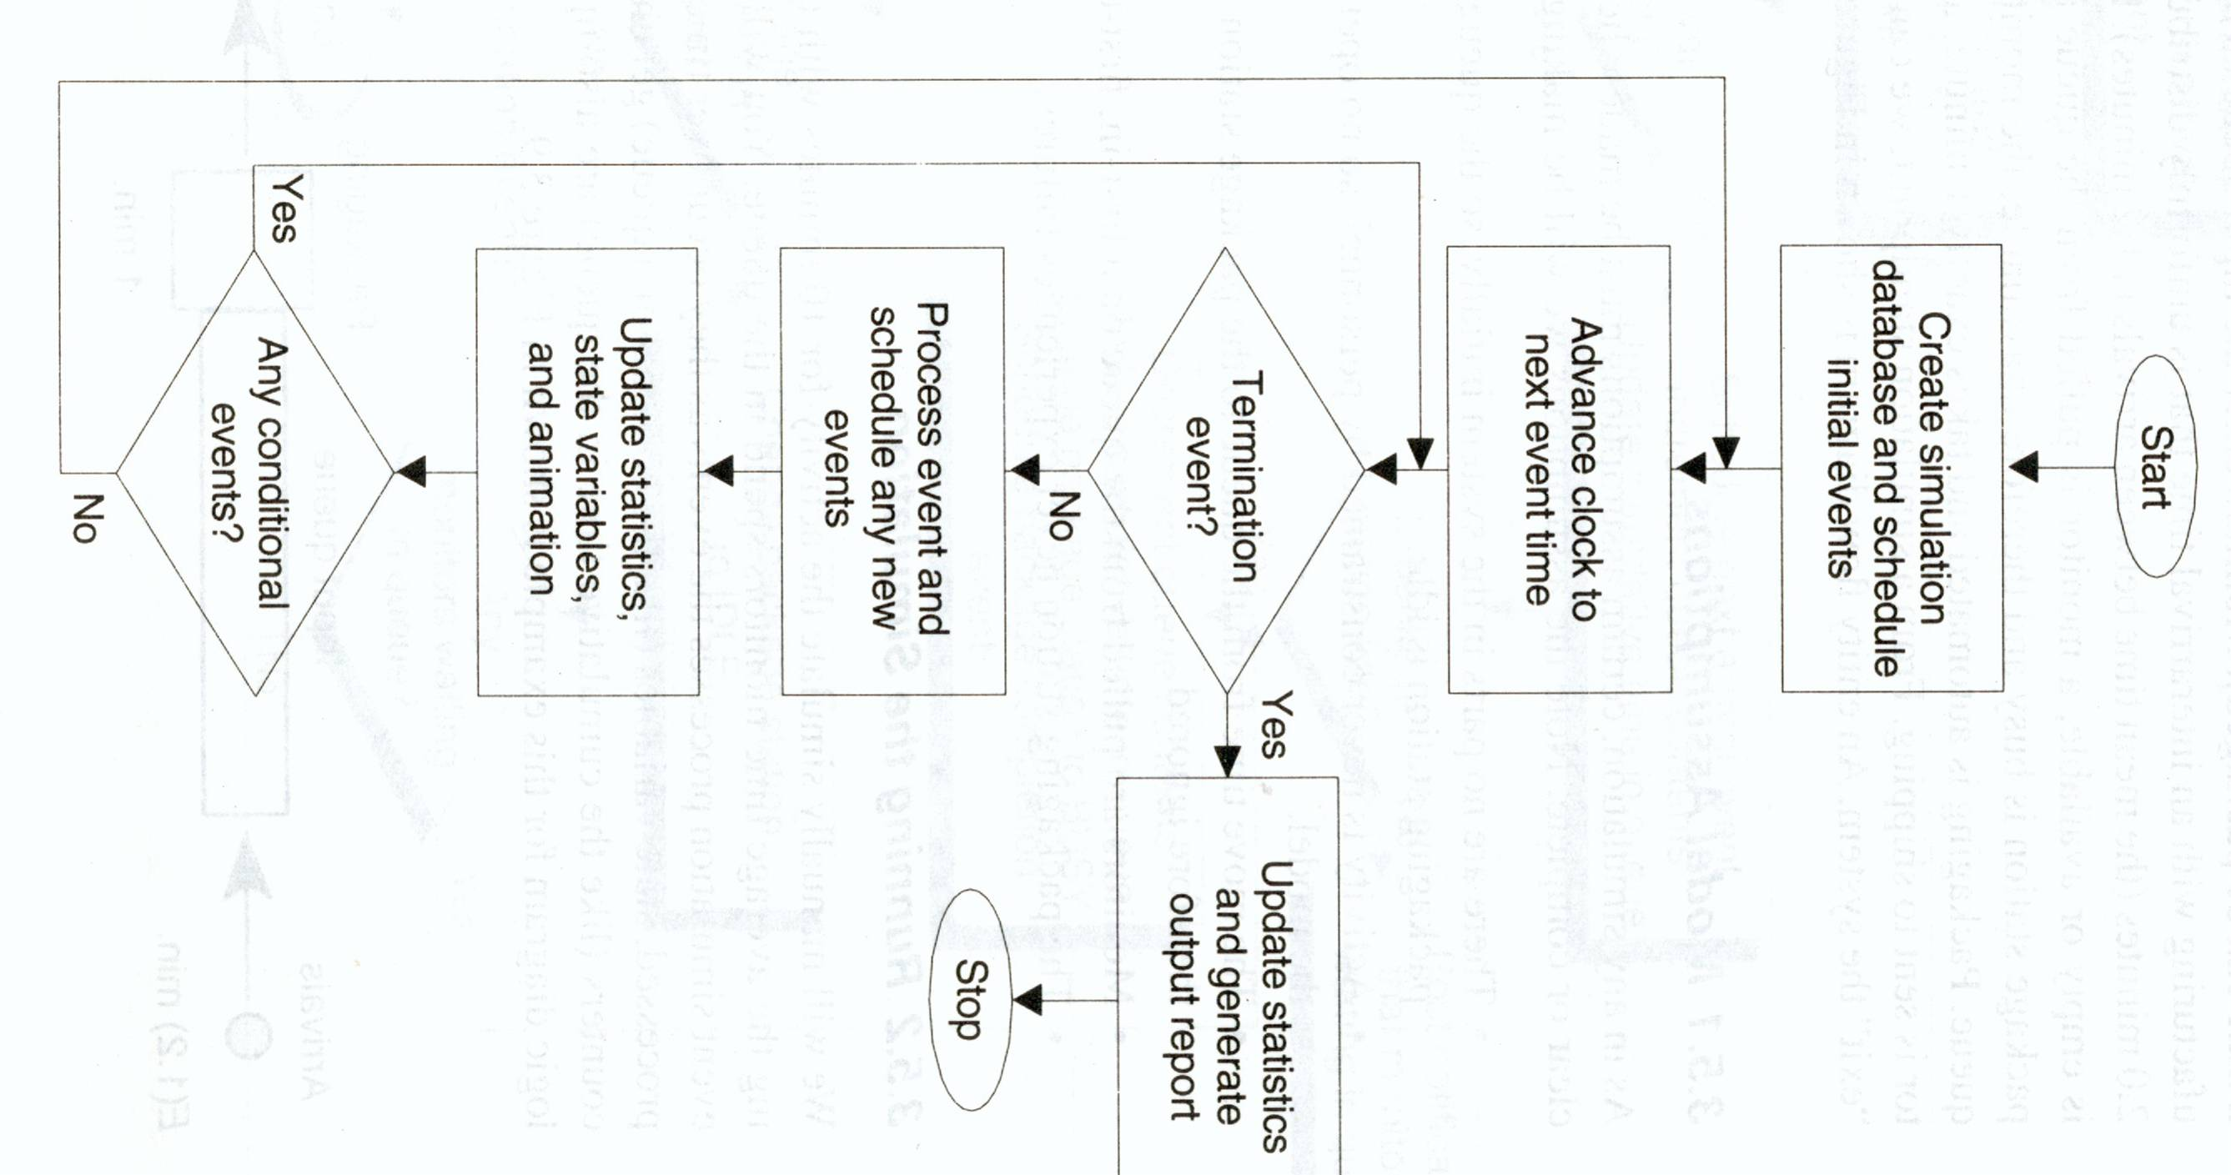
Simulation Flow Chart

